Slide 1






















Home
Faculty of Computers and Information Technology (FCIT)
Project Title: Auto Attendance
Supervisor: Dr Mohammad Naif Al-Atawi
Academic Year: 2022/23

Slide 2

Table Of Contacts
Outline
Home.
Outline.
Introduction.
Project Objectives.
Related Works.
Methodology.
Analysis.
ERD.
Conclusion.
Questions.

Slide 3
Introduction

Slide 4


There is time lost in the lectures to take the student attendance,
so how to solve it?
Problem overview:
The college needs a way to facilitate the status of attendance and absence.
The teacher loses 5-10 min to take attendance.
Introduction

Slide 5
Objectives

Slide 6

Project objectives:
Speed of attendance and absence
Objectives

Slide 7
Related Works

Slide 8
1- Time Camp
Time Camp is a presence for employees and students but lacks many basic features
Related Works

Slide 9
2- Bonsai
Bonsai is a set of tools for employees to manage attendance.
Related Works

Slide 10
3- Odoo
This site has some points similar to our program, such as attendance
Management.
Related Works

Slide 11
Methodology

Slide 12
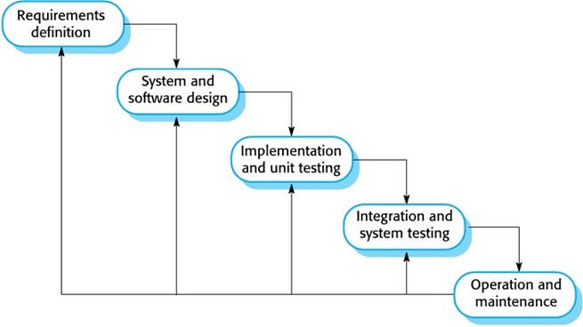
Methodology
Methodology
This project will use the waterfall methodology. The waterfall method is a project management approach that emphasizes a linear progression from the beginning to the end of a project.

Slide 13
Analysis and Design

Slide 14
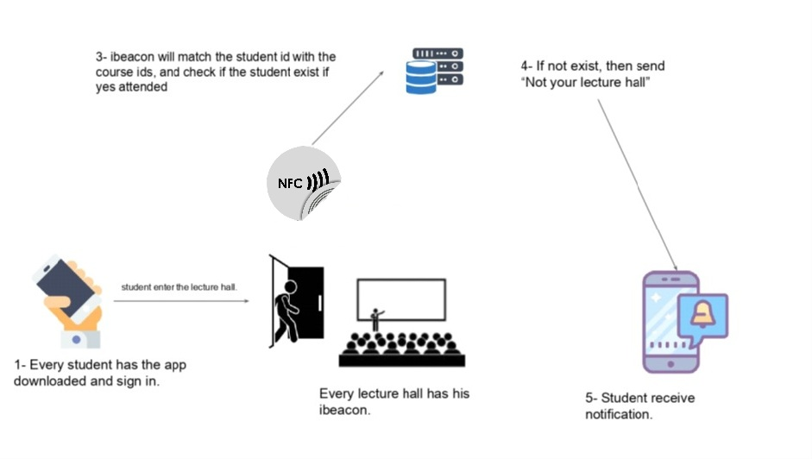
Requirement
Analysis
NFC
2-NFC will get the Signal

Slide 15
Functional Requirement
Functional requirements are product features or functions that developers must implement to enable users to accomplish their tasks.
Analysis
Administrator controls the Lecturer and the student accounts
Lecturer requests to print the state of class

Slide 16
Non-Functional Requirements
A non-functional requirement is a constraint or a requirement that the system is obligated to meet. Software quality attributes are specified in these documents.
Analysis
Connecting the NFC to the system coding.
Connecting the NCF to the database.

Slide 17
Analysis and Design
UML

Slide 18
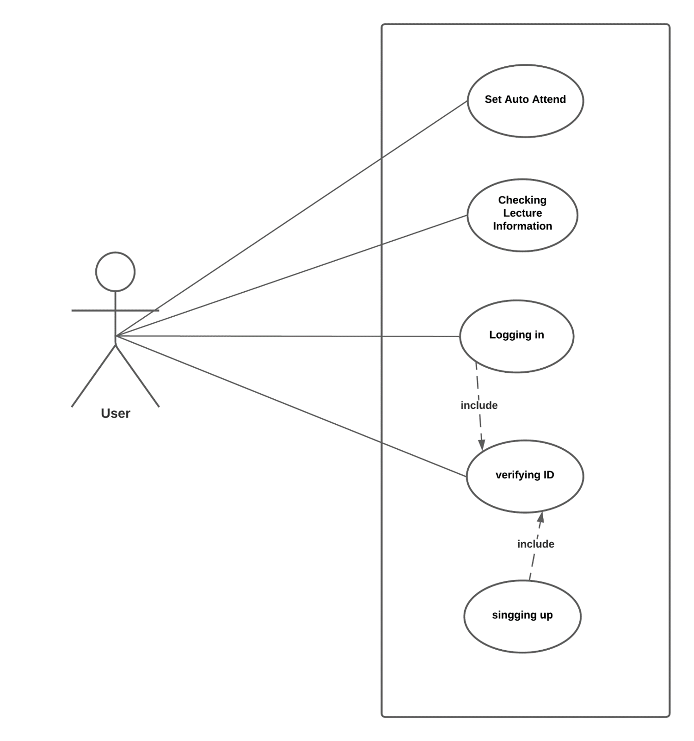
Analysis and Design

Slide 19
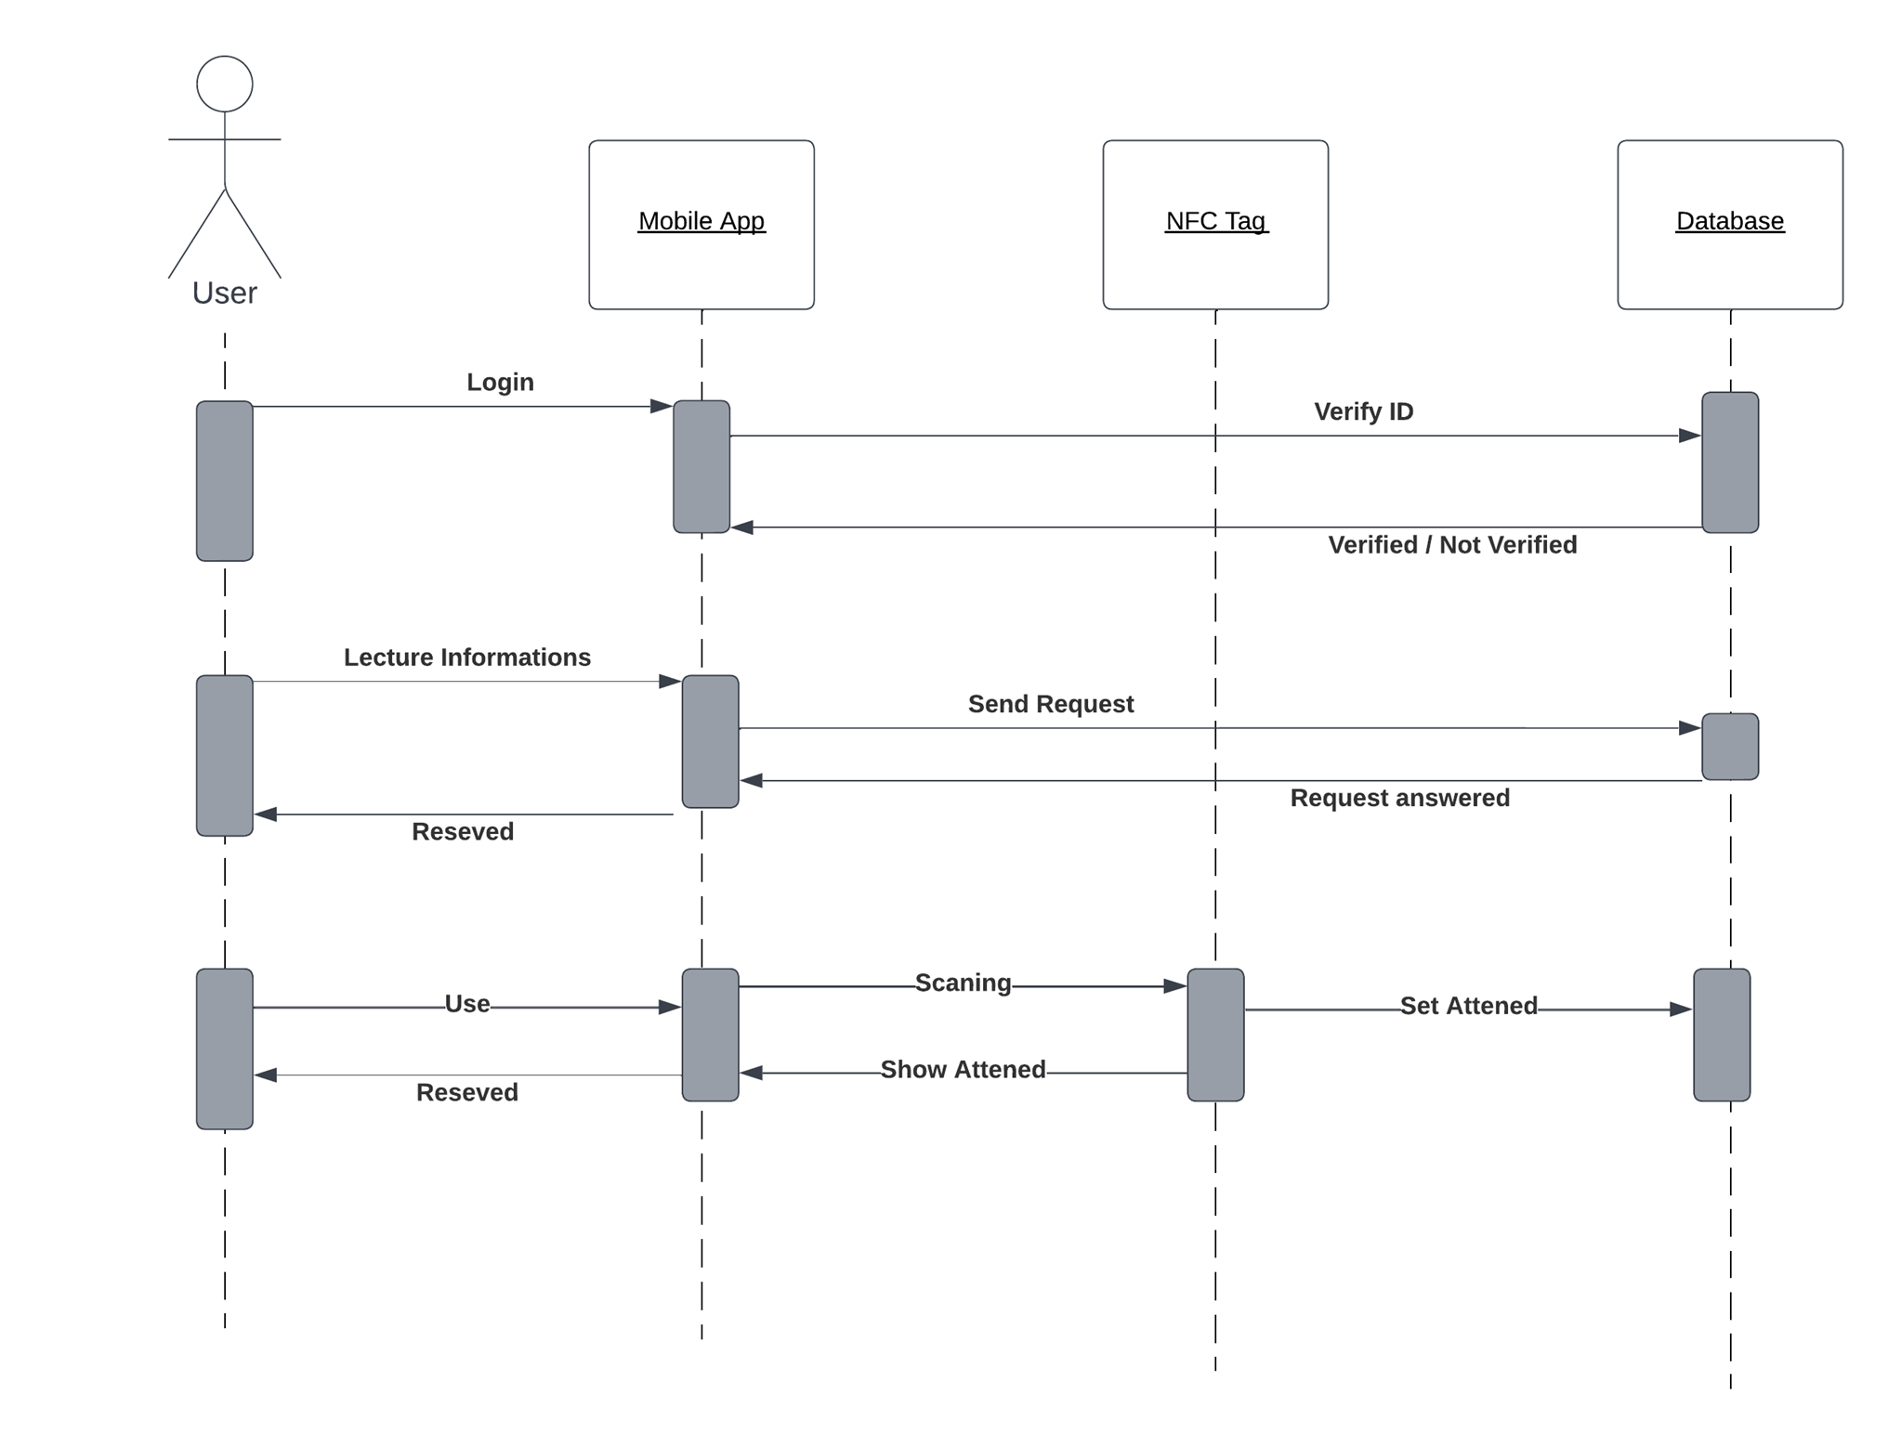
Analysis and Design

Slide 20
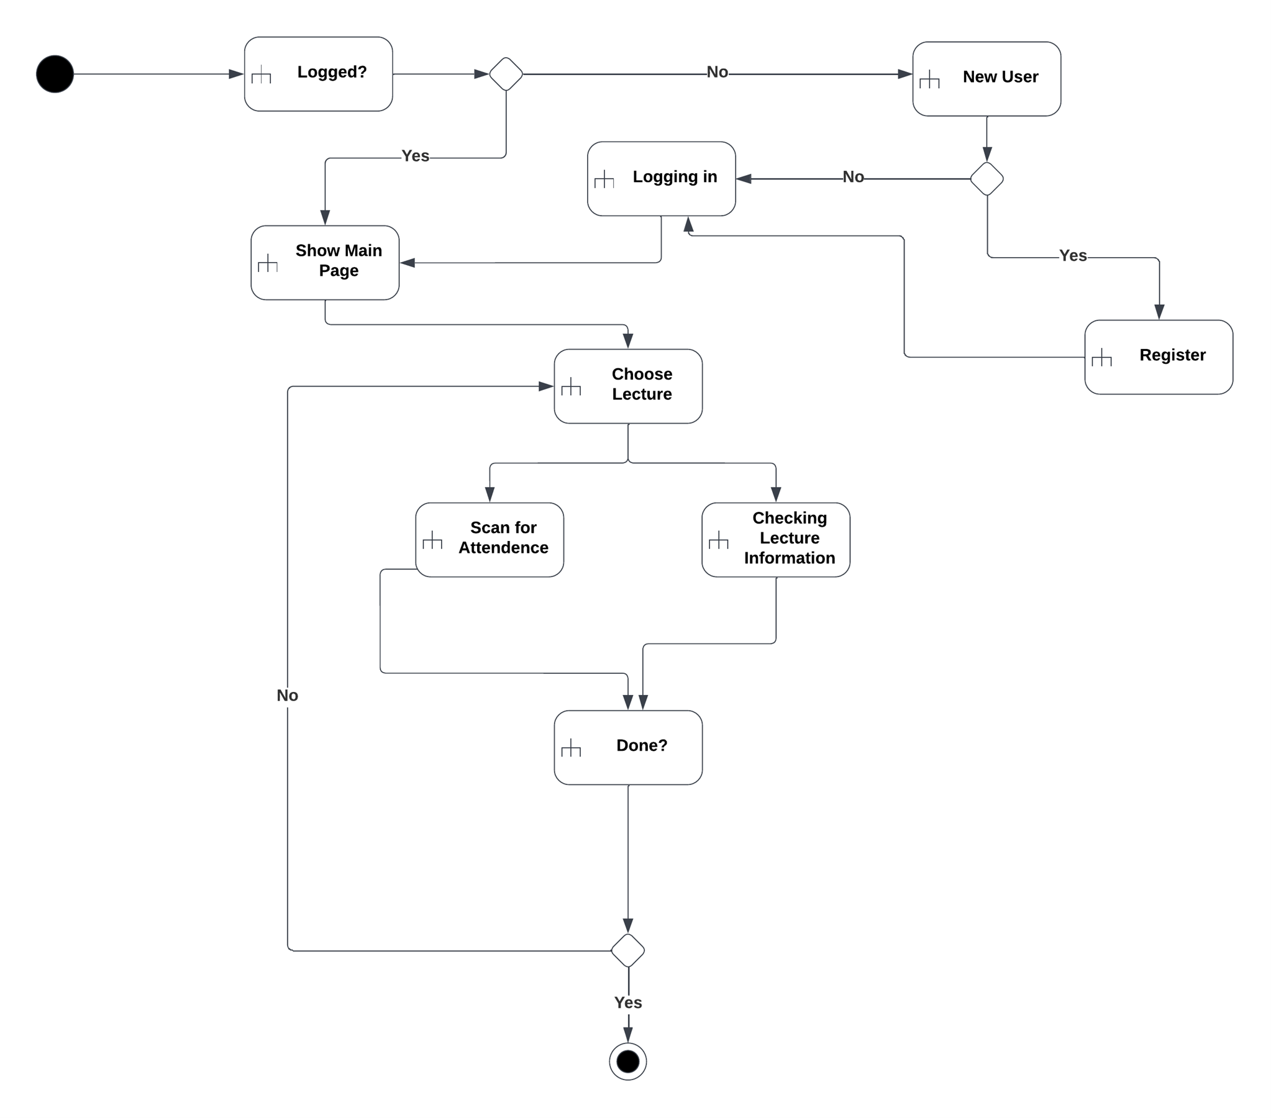
Analysis and Design

Slide 21

ERD

Slide 22
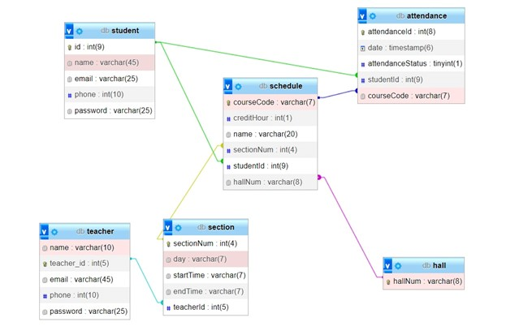
ERD

Slide 23
Conclusion

Slide 24
In conclusion, it's evident that the goal of this project was to enhance the productivity and effectiveness of the teaching and learning process. By developing a system that helps to keep teachers focused on their lectures, it has become easier for them to maximize the time spent on imparting knowledge to students. The implementation of this system has led to an increase in the productivity of both teachers and students.
By freeing up the teacher's time, they can now concentrate solely on their lecture and avoid distractions, leading to a more engaging and productive learning environment. Moreover, the system has provided students with the opportunity to be more productive and proactive in their learning. By eliminating time-consuming and distracting activities, students are now better equipped to absorb knowledge and develop critical thinking skills.
The results of this project demonstrate that by implementing systems that streamline and optimize processes, it's possible to create a more productive and efficient learning environment. This has significant implications for the education sector, and it could serve as a model for other institutions seeking to enhance their teaching and learning processes.
In short, The future looks bright, and we believe that this project will deliver great results and make a significant contribution to the education sector.
Conclusion

Slide 25
Thank You
Any Questions?
Questions?

